Slide 1
SkyAirlines Flight Booking Application
Surendar - TL
Yabesh
Thamizhvanan
Seetha

Slide 2
Table of contents
01
02
03
Introduction
Technology Stack
Features
04
05
06
Architecture
Challenges and Solutions
Development
07
08
09
Demo
Future Scope
Conclusion

Slide 3
01
Introduction
SkyAirlines is an online flight booking platform designed to simplify the flight reservation process for users, using Mern Stack.

Slide 4
Objective !
To provide a seamless and user-friendly interface for booking flights and managing reservations.

Slide 5
02
Technology Stack

Slide 6
Frontend
React.js (with Material-UI and Bootstrap for styling)

Slide 7
Backend
Database
Tools
Node.js and Express.js
MongoDB Atlas
GitHub, Postman (for API testing)

Slide 8
03
Features

Slide 9
Flight search with filters (e.g., price, airline)
Visual seat selection
User login/signup
Responsive design for mobile and desktop

Slide 10
04
Architecture

Slide 11
Visualize how the frontend communicates with the backend via RESTful APIs, and the backend interacts with MongoDB.

Slide 12
05
Challenges & Solutions

Slide 13
Challenge: Connecting the frontend and backend for real-time flight results
Solution: Designed structured APIs and debugged MongoDB configuration
Challenge: UI responsiveness
Solution: Used Material-UI and Bootstrap to enhance layout flexibility

Slide 14
06
Demo screenshots

Slide 15
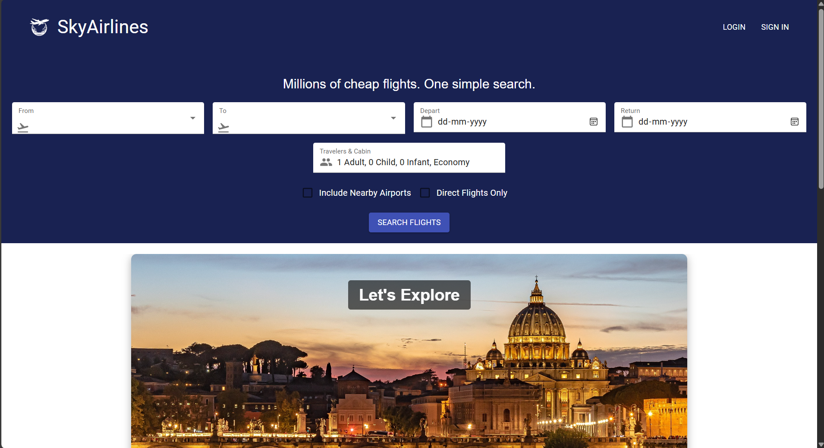

Slide 16
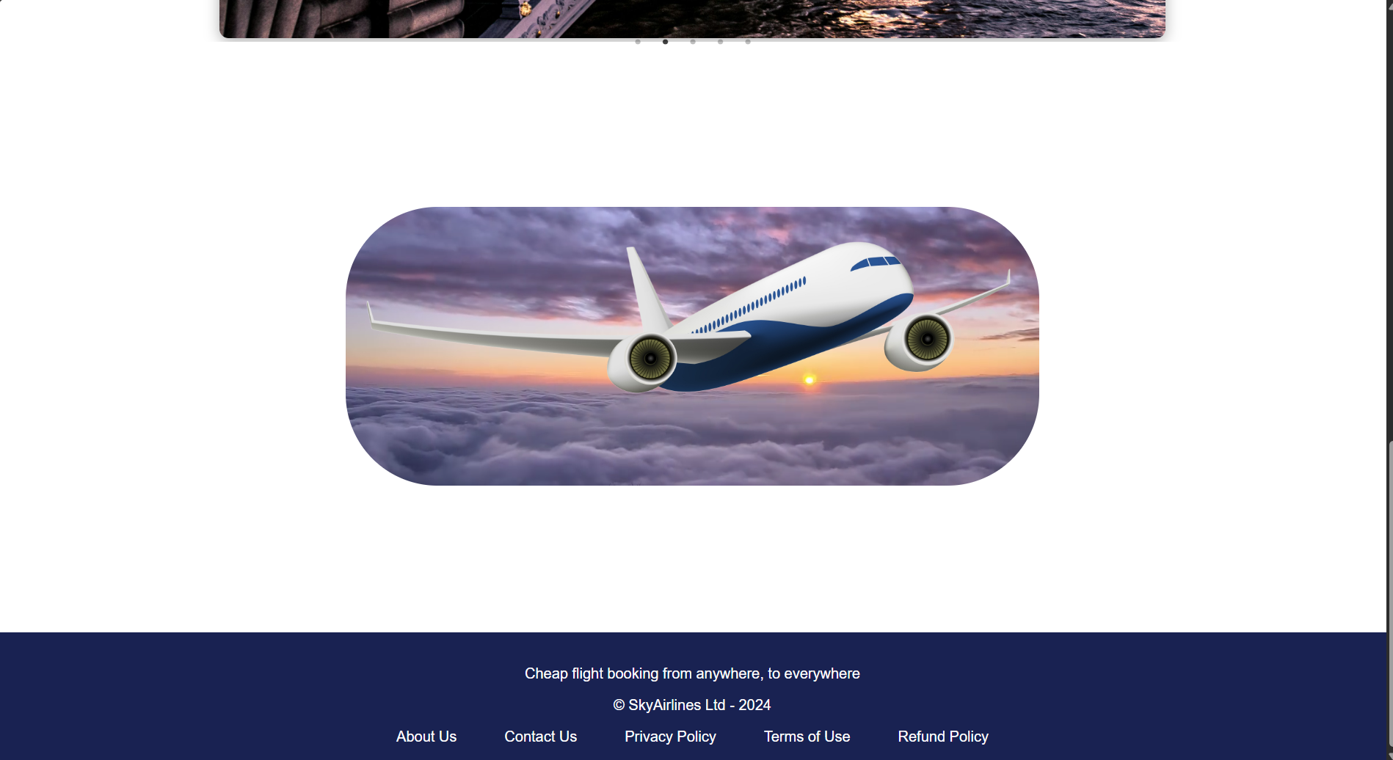

Slide 17
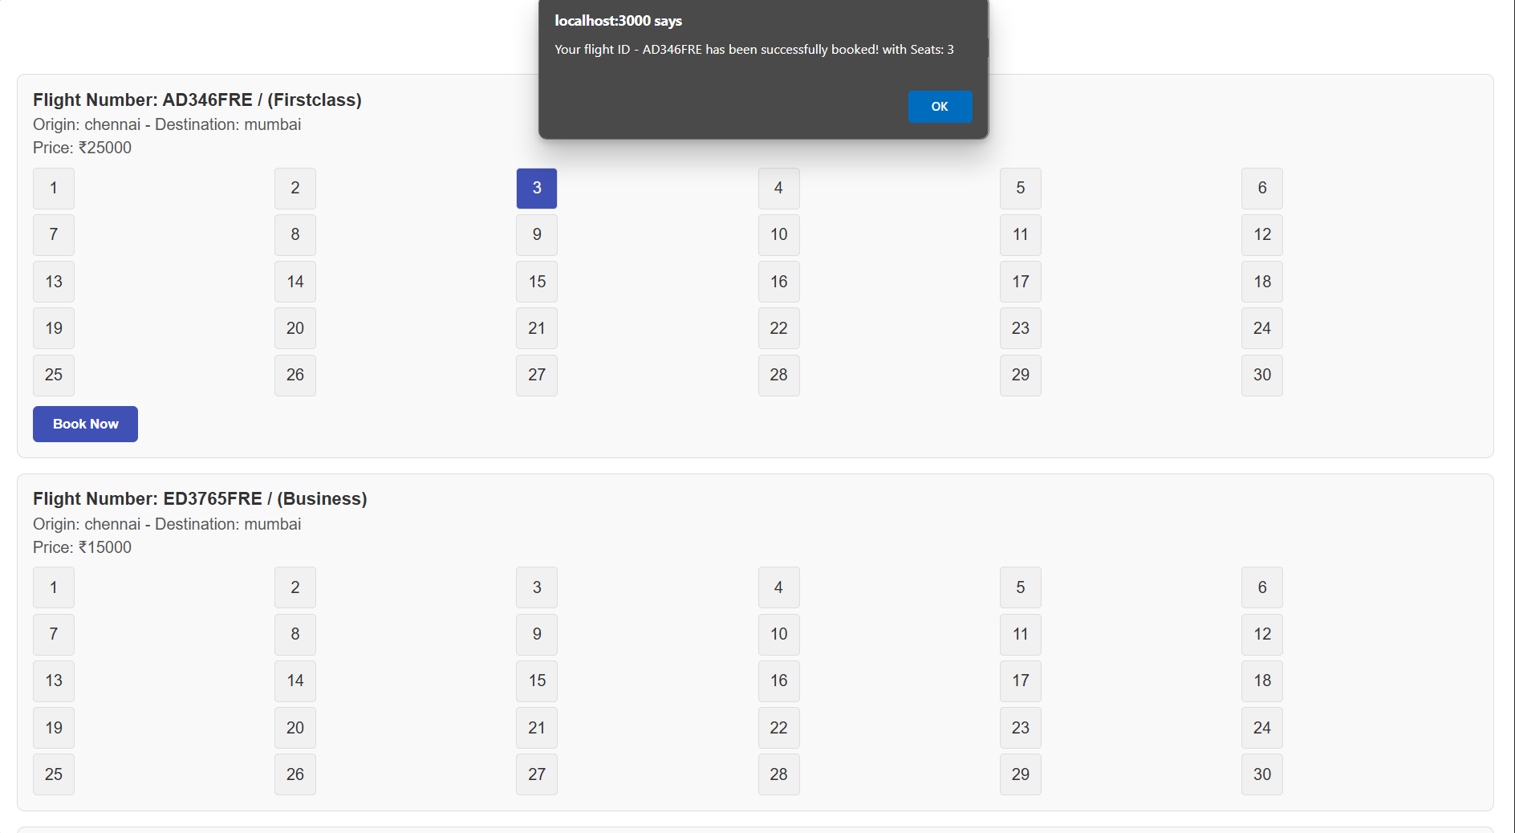

Slide 18
07
Future Scope

Slide 19
Integration of payment gateways
Loyalty programs for frequent flyers
AI-based dynamic pricing recommendations

Slide 20
08
Conclusion

Slide 21
The project demonstrates the integration of modern web technologies for real-world applications.
Improved skills in full-stack development, problem-solving, and API integration.

Slide 22
00
THANK YOU

